Slide 1


REST API TESTING TECHNIQUES FOR JAVA DEVS
DEVCON ABNAMRO 2019

Slide 2
Roger Janssen
Luminis
ABN AMRO CI [COE SD] JAVA SWAT

Slide 3

GOAL:
Demonstrating how easy it can be to get your REST API covered. From writing your own integration tests to…
… automatic integration test generation.

Slide 4
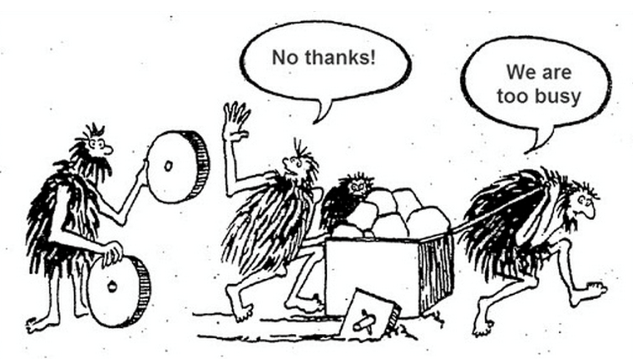

Slide 5

Jersey Test Framework

Slide 6
Jersey Test Framework
Developed by Jersey originally as internal test tool
pre-configured client to access deployed application
support for multiple (embedded) containers
able to run against any external container

Slide 7
CODING EXAMPLE

Slide 8

RestEasy

Slide 9
RestEasy
RESTEasy is JBoss's implementation of the JAX-RS specification
Support for unit tests (to write integration tests)
In-memory http servers instantiated from unit tests
CDI support

Slide 10
CODING EXAMPLE

Slide 11

RestAssured and MockMVC
(with SpringBoot)

Slide 12
RestAssured (with SpringBoot)
HTTP abstraction layer
Full focus on validation / testing
Requires your application to run (somewhere)

Slide 13
CODING EXAMPLE

Slide 14

Karate

Slide 15
Karate
Implements HTTP abstraction layer
Write Gherkin…
… and nothing else!

Slide 16
CODING EXAMPLE

Slide 17

Spring Cloud Contract

Slide 18
Spring Cloud Contract
Part of umbrella Spring Cloud project
Focus on microservice testability
Automated generation of integration tests
Automated generation of stubs representing your (micro)service

Slide 19
CODING EXAMPLE

Slide 20
Questions?

Slide 21
Useful links:
https://p-bitbucket.nl.eu.abnamro.com:7999/projects/COESD/repos/devcon2019
https://p-bitbucket.nl.eu.abnamro.com:7999/projects/COESD/repos/test-examples-jee
https://p-bitbucket.nl.eu.abnamro.com:7999/projects/COESD/repos/test-examples-springboot
https://p-bitbucket.nl.eu.abnamro.com:7999/projects/COESD/repos/test-examples-resteasy
https://p-bitbucket.nl.eu.abnamro.com:7999/projects/COESD/repos/test-example-springboot-webflux
https://p-bitbucket.nl.eu.abnamro.com:7999/projects/COESD/repos/qcon-refactoring
https://p-bitbucket.nl.eu.abnamro.com:7999/projects/COESD/repos/qcon-solid

Slide 22



